Slide 1
Ground Water Monitoring and Data Management System in Denmark
Dr. Ole Larsen, DHI
Dr. Lærke Thorling, GEUS

Slide 2
Danish Water Forum
Established in 2003
Water knowledge network of Danish stakeholders
>50 members: Universities, Producers of equipment, Consultants, Water Companies, Authorities, NGO’s etc.
Support to the Danish water research society
Support to the Danish Ministry of Foreign Affairs
Promotion of Danish knowledge through export
Promotion of knowledge sharing in Denmark
Office in India
Your gateway to Danish Water Technology!

Slide 3
DHI in brief
50
50
More than 1100 staffs
30 international offices
60 staff in India
Not-for-profit
OVER
MANAGING WATER
SCIENCE TO PRACTISE
28
%
%
YEARS EXPERIENCE IN WATER AND RISK MANAGEMENT
OF REVENUE USED FOR R&D
OF GLOBAL CATCHMENTS
100
1
Water management to
DEVELOPED OVER
WORLDS’S TOP
1
Billion
ONLINE FORECASTING SYSTEMS
MODELLING FIRM
Citizens or more

Slide 4
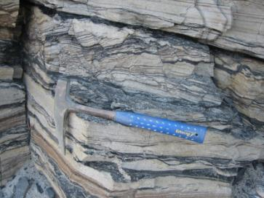
GEUS in brief
125 years as a research institution
330 staff, incl. more than 200 scientists (~ more than 300 full time positions)
Turnover: US$ 80M – of which more than 50% derive from external projects
Offices in Denmark and Greenland
Independent research and advisory Institute in the Ministry of Climate, Energy and Building

Slide 5
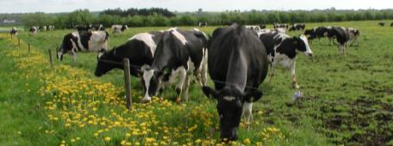
Background
Groundwater constitutes 100 % of the drinking water resource in Denmark
Groundwater is heavily exploited in some area
63% of land-use for agriculture
Groundwater quality and quantity crucial for surface waters
History
  1900: Central registration of bores
  1950: First national groundwater table monitoring programme
  1988: The national groundwater monitoring programme initiated
  2004: The national groundwater table monitoring programme is integrated in the overall monitoring programme
  2007: The Water Framework Directive initiates a change in monitoring strategy and redesign of the monitoring network

Slide 6
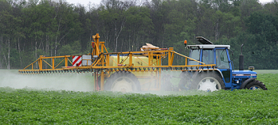
What is Groundwater monitoring?
Groundwater monitoring collects data of relevance for policy and management issues in the water sector. Special focus on establishment of time series and of mapping:
  Groundwater quantity
  Groundwater table soundings
  Water abstractions
  National hydrological model
  Groundwater quality
  Groundwater samples from
  Monitoring wells
  Abstraction wells at all water works wells in DK
  Data from private drinking water wells are NOT used to asses national status or trend.

Slide 7
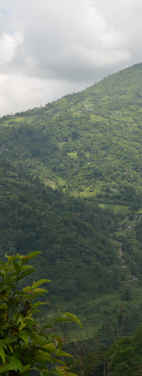
Why do we need Groundwater Monitoring?
Researach and development
Methodology
Interpretation
Mangagement
Policy
EU directives
Dissemination
Yearly reports
Cooperation EPA, EU etc.
Dating
Water cycle
Waterplans other planning
Inspection of water works
Thematic reports
Intercalibration
Lectures and talks
Articles
Analytical methods
Municipalities and EPA
Modeling
European Env. Agency
Efficiency of measures
Notes:
Overvågning er som skovbrug, vi samler data ind vores efterkommere, sidder man længe nok har man selv glæden heraf.
Forskningsmæssigt specielt område, hvor man arbejder med data man ikke selv har skabt, som ofte er heterogene i tid og sted.

Slide 8
Flow of Groundwater Monitoring Data
Environmental Agency/ Water Works Laboratory Laboratory Consultants/GEUS/DHI GEUS/DHI/Universities Environmental Agency Minister/Parliament EU Commission + EEA Municipalities etc. | Sampling & field measurements (Standards) Chemical analysis (ISO- standards) Data, upload to databases JUPITER, (code system) Interpretation (Reporting, modelling + data to EEA) Knowledge Political evaluation Political reaction/legislation Political reaction/legislation Implementation in administration

Slide 9
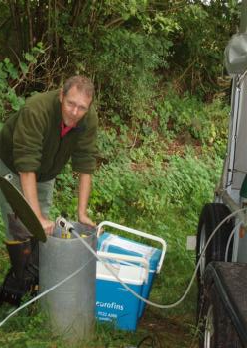
Monitoring strategy
Need for representative data:
Geographic Geological geochemical Land use and groundwater in risk. | Relevant choice of parameters Relevant frequency Design of monitoring wells
1988-2006: Principle: Know the details in 72 areas and generalise to national level Understand the local dynamics Use it global All monitoring points same parameters and frequency | 2007: Principle: WFD demands monitoring fitting to approx. 400 groundwater bodies More distributed monitoring network under establishment Parameters and frequency according to risk
Difficult to stick to just one monitoring strategy in a changing political environment.

Slide 10
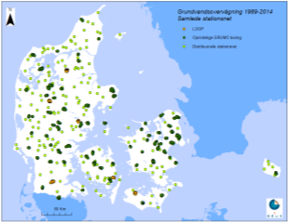
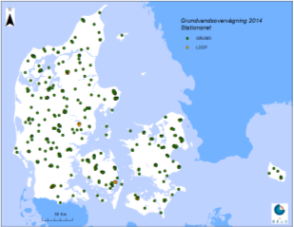
Present Design
Danish Groundwater Monitoring sites
Monitoring in 65 clustered areas of 5-50 km² each with 20-25 wells and 1 m screen. (700 samples/year)
Additional monitoring in groundwater bodies at risk (140 samples/year)
Multilevel monitoring in 5 deep groundwater well (4x80 samples every 3. year)
Detailed monitoring of surface near groundwater in 5 small agricultural catchments (6x100 samples/year)
A total of 1600-2000 monitoring points
One water sample (up to 97 parameters):
  26 main elements,
  14 heavy metals,
  23 organic micro-pollutants, and
  34 pesticides

Slide 11
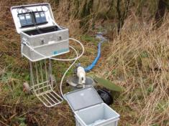
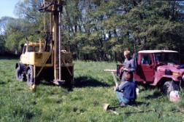
Methodologies and tools
Field work/ Practical work
Water sampling and drilling new wells
Traditional hydrogeological field work
Database development and handling of data
Incorporation of state of art scientific work
“5D” conceptual framework for data interpretation
All authors in reporting have their theme as scientific working field
Monitoring groundwater effect on surfacewater/dependent ecosystems
Cooperation at a EU level (CIS for WFD)
Cooperation with EEA
Technical guidance
  Field work, sampling, sounding etc.
  Data management, database work

Slide 12
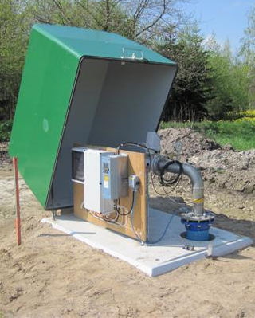
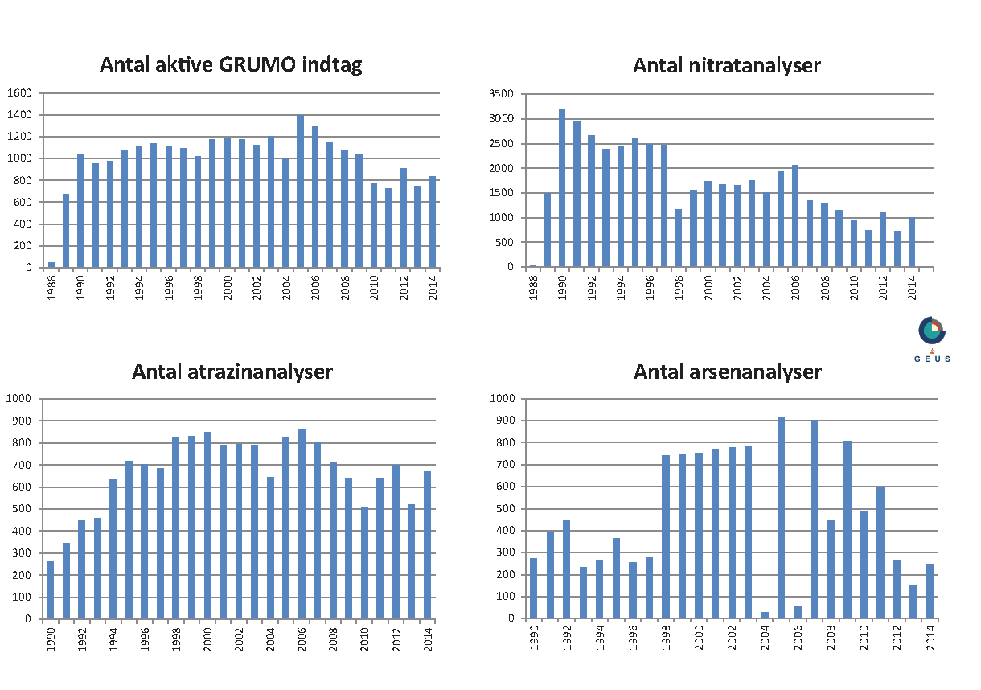
Data available for interpretation
Number of monitoring points
Number of nitrate samples
Number of pesticide sampes
Number of arsenic samples

Slide 13
The annual report
Theme authors with expertise in relevant subject
Same paradigm for every 6 year program period
Target groups: Danish parliament, EPA, Waterworks, NGO etc.
Reporting is coordinated with other environmental monitoring programmes
Only electronic reporting
Only national reporting, no regional
Published every year since 1989
Next issue 3. Dec. 2016 on 2015 data

Slide 14
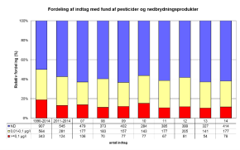
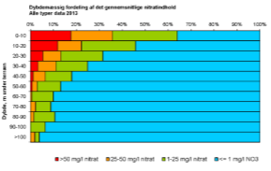
Main topics of the Report
The monitoring network, goals, legal framework and adjustments
Groundwater Age, Hydrogeology: Relevant Background Knowledge
Nitrate
Phosphorous
Redox-wells
Organic Micro pollutants
Trace elements
Pesticides
Water abstraction
Groundwater table
NOVANA-model

Slide 15
“5D” understanding of groundwater quality:
Prerequisite for monitoring strategy and interpretation of Chemical state, Trend and Dynamics
Every sample represents a 5D point: (x,y,z,t_{r},t_{s}).
  (x,y,z) the location of the filter,
  t_{r} the time of groundwater recharge, (period)
  t_{s} the time of sampling.
“5D” understanding of groundwater is significantly aided by modelling
Conceptual models
Integrated catchment models

Slide 16
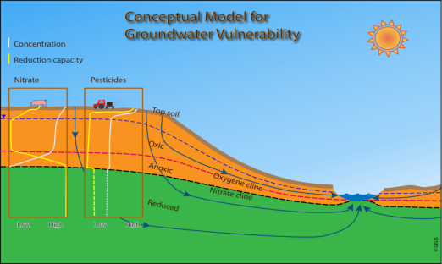
Conceptual models are the Basics of all monitoring strategy
Example of concept to understand the vulnerability of groundwater towards nitrate and pesticides

Slide 17
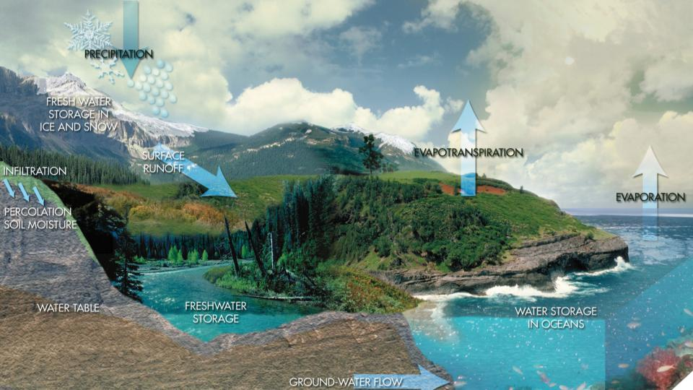
The Water Cycle

Slide 18
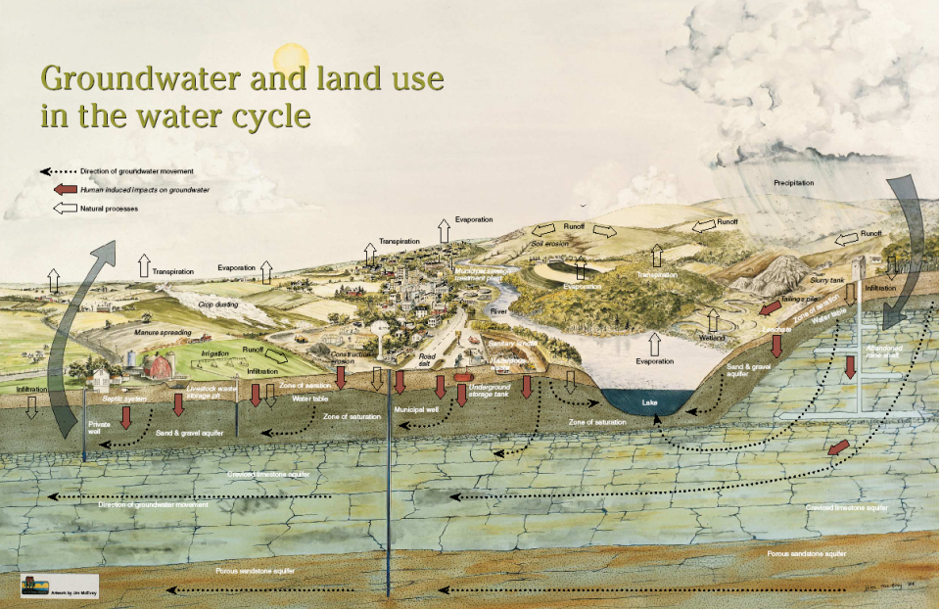
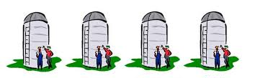
Water management is in silos
Do we have enough data?
Do we share our data?
Groundwater
Surface water
Soil Science
Ecology

Slide 19
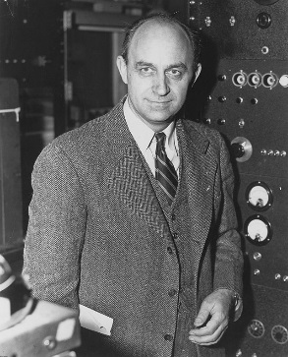
The Classic Fermi Problem
Enrico Fermi
physicist
1901 – 1954
"How many piano tuners are there in Chicago?"
Replace the question by (a model):
How many people live in Chicago?
How many persons on average are in each household in Chicago?
What fraction of households has a piano that is tuned regularly?
How often is a piano tuned?
How long does it take to tune a piano (with travel time)?
How many hours does a piano tuner work per day/week/year?

Slide 20
The Classic Fermi Problem
Enrico Fermi
physicist
1901 – 1954
"How many piano tuners are there in Chicago?"
Replace the question by (a model):
How many people live in Chicago?
How many persons on average are in each household in Chicago?
What fraction of households has a piano that is tuned regularly?
How often is a piano tuned?
How long does it take to tune a piano (with travel time)?
How many hours does a piano tuner work per day/week/year?
How many people live in Chicago? ~9,000,000 people
How many persons on average are in each household in Chicago? ~ 2
What fraction of households has a piano that is tuned regularly? ~ 1 in 20
How often is a piano tuned? ~ Once per year
How long does it take to tune a piano (with travel time)? ~ 2 hours
How many hours does a piano tuner work per day/week/year?
8 hrs/5 days/50 weeks
= ~ 225 piano tuners
Actual number of piano tuners is ~ 290 !

Slide 21
Water management is in silos
Do we have enough data?
Never enough data
Data is also a skills/people issue
Accuracy is a management decision
Groundwater
Surface water
Soil Science
Ecology

Slide 22
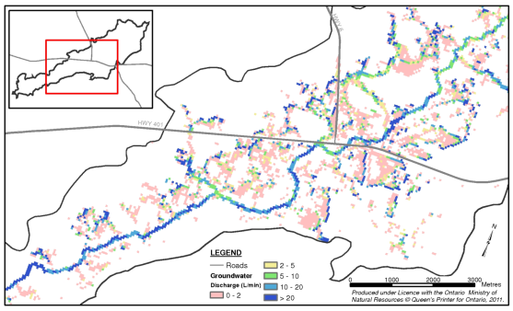
The Recharge Challenge
Groundwater & Surface Water interactions are key to catchment hydrology
The driving force behind groundwater inflow to streams is Recharge
Groundwater discharge areas
Recharge is;
Highly complex,
Spatially distributed
Temporally distributed (dynamic),
Difficult to predefine as a simple boundary condition as is done with traditional groundwater models

Slide 23
The Classic Groundwater Problem
Enrico Fermi
physicist
1901 – 1954
"How much is the groundwater recharge?"
Replace the question by:
What is the rainfall?
What is the infiltation rate?
  What is the slope?
  What is the land use?
  What is the evapotranspiration?
    What is the vegetation type?
    How deep are the roots?
    What is the potential evapotranspiration?
Educated guesses are good enough to get started

Slide 24
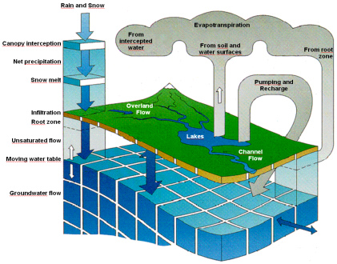
The Water Cycle
Precipitation and snowmelt
Integrated water quality
Vegetation based evapotranspiration and infiltration
Demand driven water use
Unsaturated groundwater flow
Overland surface flow and flooding
Saturated groundwater flow
Channel flow
  A fully integrated model partitions rainfall into
  runoff, infiltration and ET

Slide 25
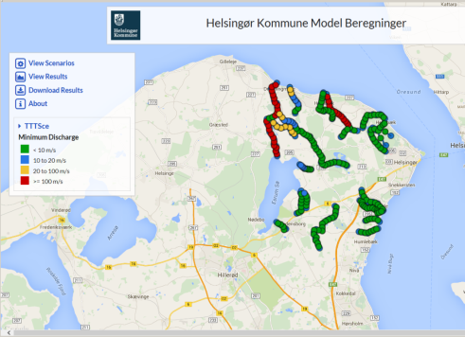
Active models – hosted solutions
Characteristics
Model belong to client
Strengthening links to consultants
Results dissemination
Online access to model/model scenarios and data
Tailored to client
Variety of business models – often subscription
Examples
  Elsingor municipality groundwater model
  http://193.3.62.89/Helsingor/map

Slide 26
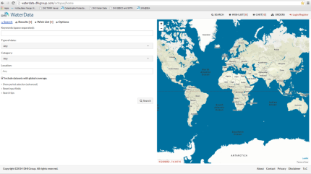
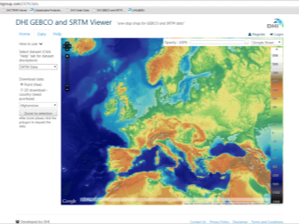
Data portal Data Viewer
Search and download data:
Provide access to many (30+) different data
Download data (rectangles)
Access to specialized viewers
Show only one data entry
Search and download data:
Provide access to selected data
Download data for relevant area and time
Derived data
http://waterdata.dhigroup.com/DEM/data
http://waterdata.dhigroup.com/trmm/trmm-data

Slide 27
More information
National database of bores (JUPITER): http://www.geus.dk/jupiter/index-dk.htm
With geologic information from over 240.000 wells. Download of well reports with geologic descriptions, Graphical view of wells and data for groundwater chemistry:
National geophysical database (GERDA): http://www.gerda.dk/index.html
Geophysical database for environment and resources, geophysical methods, dataexchange and data download:
Homepage for groundwater monitoring: http://www.Grundvandsovervaagning.dk
National fully integrated hydrological model: http://www.vandmodel.dk
Water Data Portal: http://waterdata.dhigroup.com

Slide 28
Thank you for your attention!
Dr. Ole Larsen, DHI
Dr. Lærke Thorling, GEUS

